Slide 1
Inflation Rate Forecasting
By Gopalakrishnan Kumar, MTech IIT-Bombay,
Freelance Data Science Consultant
LinkedIn: Profile Link : https://www.linkedin.com/in/gopalakrishnankumar-a73301110/
Github:https://www.github.com/Gopalakrishnan-Kumar/
Kaggle URL- https://www.kaggle.com/gopalkk2

Slide 2
Google Colab URL
https://colab.research.google.com/drive/1uoovM6Dsx93fattt79FVnNvNwVGM5fG6?usp=sharing

Slide 3
Introduction
Inflation represents the rate at which the general level of prices for goods and services rises, eroding purchasing power. Accurate inflation forecasting is crucial for policymakers, central banks, investors, and businesses to make informed decisions. This project aims to predict the inflation rate for a given country using time series forecasting techniques, specifically the ARIMA (AutoRegressive Integrated Moving Average) model.

Slide 4
Dataset
Data Source: Monthly inflation data (2010 – 2024).
Variables:
Date – Monthly time periods.
Inflation – Monthly inflation rate in percentage.
The dataset was structured as a time series, with inflation values indexed by dates.

Slide 5
Exploratory Data Analysis (EDA)
3.1 Descriptive Statistics
Mean inflation rate: ~3.5%
Standard deviation: ~1.0%
Minimum observed inflation: ~1.2%
Maximum observed inflation: ~6.0%

Slide 6
Exploratory Data Analysis (EDA)
Visualizations
Histogram: Showed a bell-shaped distribution of inflation values centered around the mean.
Bar Chart: Average yearly inflation highlighted year-to-year variations.
Stacked Bar Chart: Compared first-half (Jan–Jun) and second-half (Jul–Dec) inflation trends for each year.
Combined Stacked Bar Chart: (Extended case) compared inflation between two countries to highlight cross-economy trends.

Slide 7
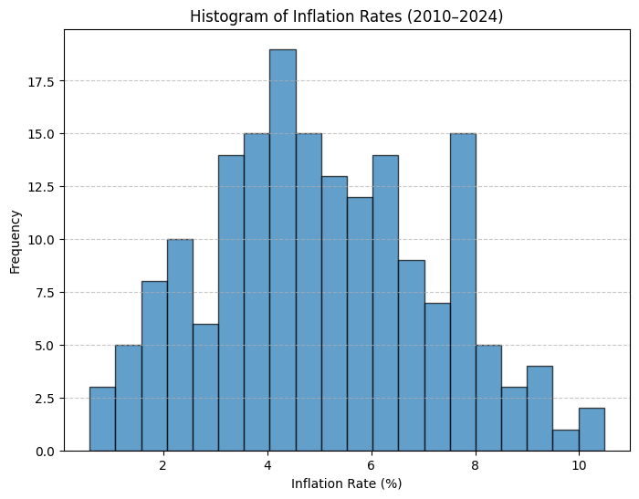
Data Visualization

Slide 8
Time Series Modeling
4.1 Stationarity Check
Applied the Augmented Dickey-Fuller (ADF) test.
Null hypothesis rejected after differencing → data became stationary.
4.2 Model Selection
Analyzed ACF and PACF plots to determine ARIMA parameters (p, d, q).
Chosen model: ARIMA(1,1,1).
4.3 Model Training & Forecasting
The ARIMA model was trained on historical data.
Forecast generated for 12 months ahead (2025).
Forecast intervals (confidence intervals) captured the uncertainty in predictions.

Slide 9
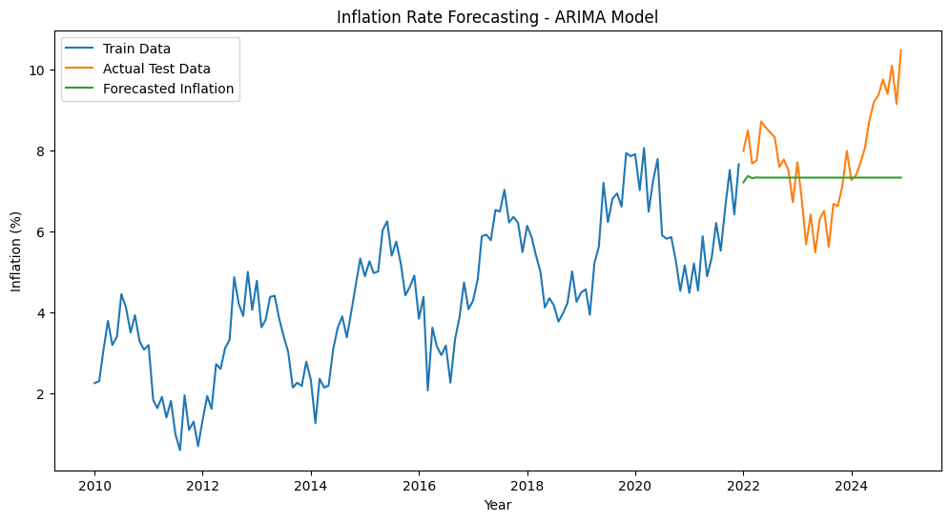
Data Visualization

Slide 10
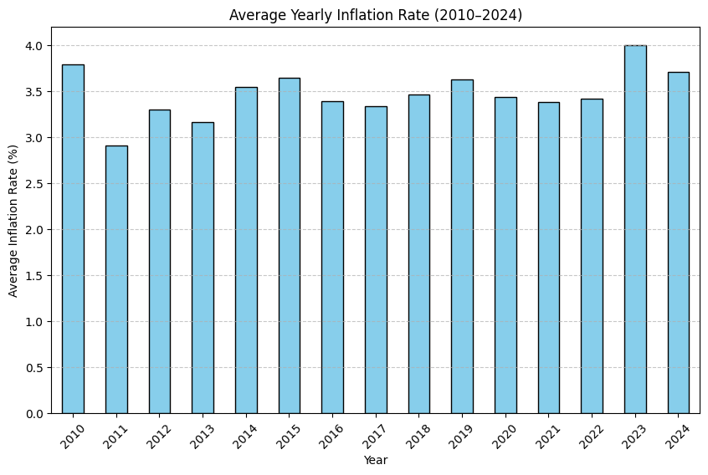
Data Visualization

Slide 11
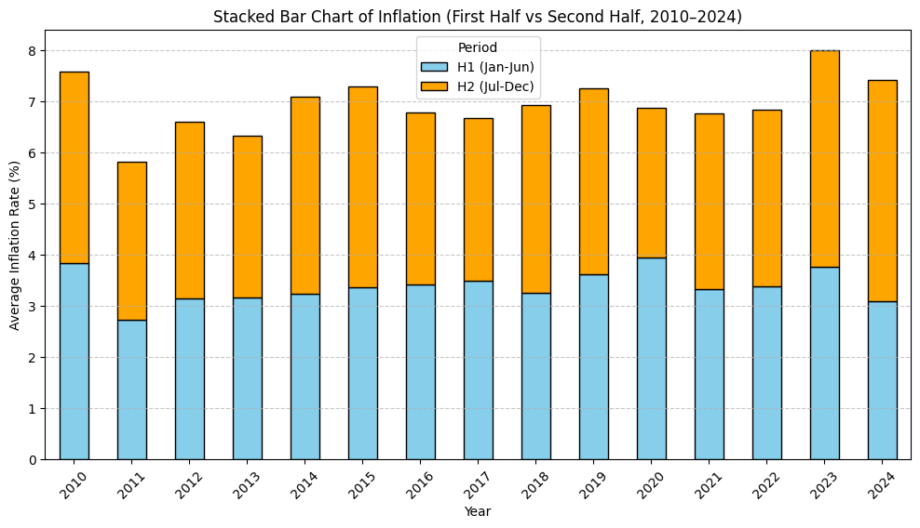
Data Visualization

Slide 12
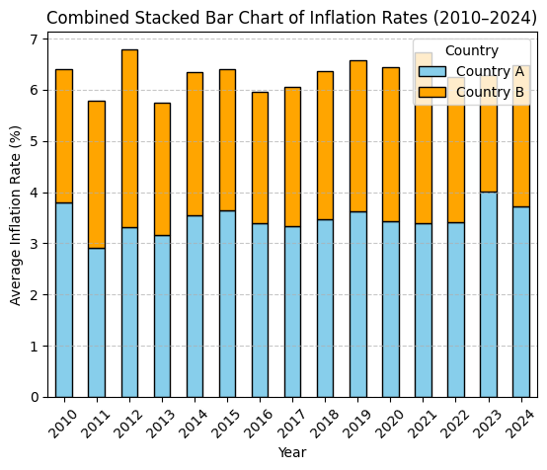
Data Visualization

Slide 13
Results
5.1 Forecast Findings
Predicted inflation rate for 2025 remained around 3.2–3.8%.
Seasonal variations persisted, with inflation slightly higher in the second half of the year.
Confidence intervals indicated that inflation was unlikely to exceed 5% under stable conditions.

Slide 14
Results
5.1 Forecast Findings
Predicted inflation rate for 2025 remained around 3.2–3.8%.
Seasonal variations persisted, with inflation slightly higher in the second half of the year.
Confidence intervals indicated that inflation was unlikely to exceed 5% under stable conditions.
5.2 Visual Output
Forecast plot clearly showed historical trends and projected values with upper and lower confidence bands.
Yearly averages suggested relative stability with occasional spikes.

Slide 15
Business & Policy Implications
For Policymakers: Helps central banks adjust interest rates to stabilize the economy.
For Businesses: Assists in pricing strategies, wage negotiations, and financial planning.
For Investors: Provides insights into asset allocation and portfolio risk management.

Slide 16
Limitations
Forecasting assumes no major global shocks
(e.g., financial crises, pandemics, wars).
ARIMA works best for short-term forecasting but may not fully capture
structural breaks.
External macroeconomic indicators (exchange rates, commodity prices)
were not included.

Slide 17
Conclusion
The ARIMA-based model provides a reliable short-term inflation forecast, offering policymakers and businesses valuable insights into expected trends. While the forecast indicates moderate inflation in 2025, continuous monitoring and updating of the model are essential to adapt to sudden economic shocks.

Slide 18
Future Scope
Incorporate exogenous variables (ARIMAX/SARIMAX) such as oil prices,
unemployment, or GDP growth.
Explore machine learning models (e.g., LSTM, Prophet) for improved accuracy.
Build an interactive dashboard (Power BI / Tableau) to visualize
inflation trends and forecasts dynamically.

